Slide 1
A review on Recommender Systems Parisa Lak
Date: January 16th 2015

Slide 2
248 828 2971 4979 728
308 993 5936 9955 1411
521 1664 13718 26502 3013
708 1606 17103 37709 3663
566 767 10615 25338 2099

Slide 3
What are the Recommender Systems?
Systems for recommending items to users based on examples of their preferences
Monitoring past behavior or previous ratings
Items can be books, movies, connections (people), web pages, papers,…
Users can be customers, social media members, web browsers, researchers, …
Based on the core assumption that users who have expressed similar interests in the past will share common interests in the future [Goldberg et al. 1992]

Slide 4
Recommender Systems
Recommender systems reduce information overload by estimating relevance
Collaborative filtering : What is popular in a community
User profile & community information
Content Based: Provides more of what user liked before
User profile & Item profile

Slide 5
Recommender Systems
Knowledge Based : What is best based on the users’ needs
User profile & Item profile & Knowledge Model
Hybrid Method: Combination of inputs and/or composition of different methods
User profile & Item profile & knowledge Model & Community Information

Slide 6
Collaborative Filtering Method
Maintain a database of many users’ ratings of a variety of items
For a given user, find other similar users whose ratings strongly correlate with the current user
Find and recommend items rated highly by these similar users, but not rated by the current user
Almost all existing commercial recommenders use this approach (e.g. Amazon)

Slide 7
Problems with Collaborative Filtering
Cold Start: There needs to be enough other users already in the system to find a match.
Sparsity: If there are many items to be recommended, even if there are many users, the user/ratings matrix is sparse, and it is hard to find users that have rated the same items.
First Rater: Cannot recommend an item that has not been previously rated.
Popularity Bias: Cannot recommend items to someone with unique tastes.
Tends to recommend popular items.

Slide 8
Content-Based Recommending
Recommendations are based on information on the content of items rather than on other users’ opinions
Uses a machine learning algorithm to induce a profile of the users preferences from examples based on the description of content

Slide 9
Advantages of Content-Based Approach
No need for data on other users
No cold-start or sparsity problems
Able to recommend to users with unique tastes
No Popularity bias problem
Able to recommend new items
No first-rater problem
Can provide explanations of recommended items by listing content-features that caused an item to be recommended

Slide 10
Disadvantages of Content-Based Method
Requires content that can be encoded as meaningful features
Users’ tastes must be represented as a learnable function of these content features
Unable to exploit quality judgments of other users
Unless these are somehow included in the content features

Slide 11
Recommender Systems Challenges
Dealing with Big Data problems
Lack of Useful Data
Unstructured data
Missing Data
New user and New Item
Cold Start problem
Temporality
Changing Data
Changing user preferences and biases

Slide 12
Recommender System Evaluation Methods
Accuracy Measures
User satisfaction
Satisfaction of the recommendation provider
A myriad of evaluation techniques has been proposed
Which one is the best in a given application domain?
What are the success factors of different techniques?

Slide 13
Evaluating Recommender Systems
Evaluations on historical datasets measuring accuracy
Most popular datasets
Movies (MovieLens, EachMovie, Netflix)
Web 2.0 platforms (tags, music, papers, …)
Most popular measures for accuracy
Precision/Recall
Items are classified as good or bad
MAE (Mean Absolute Error), RMSE (Root Mean Squared Error)
Items are rated on a given scale

Slide 14
Collaborative Filtering beyond the User-Item Matrix: A Survey of the State of the Art and Future Challenges
YUE SHI, MARTHA LARSON, and ALAN HANJALIC, Delft University of Technology
ACM- Computing Surveys 2014

Slide 15
Collaborative filtering
Using User-Item Matrix
Memory based
User based
Item based
Model based
Based on prediction models that have been trained using the U-I matrix, in whole or in part, as input [Adomavicius and Tuzhilin 2005; Ekstrand et al. 2011].

Slide 16

Memory based Collaborative filtering
User based approach based on user similarities
Predict a target item by aggregating the ratings that a few similar users have previously given to that item [Resnick et al. 1994]
Similar users are identified using a similarity metric, usually the Pearson correlation or the cosine similarity [Singhal 2001]

Slide 17

Memory based Collaborative filtering
Item-based approaches
Based on information about other items that a user has previously rated [Deshpande and Karypis 2004; Linden et al. 2003; Sarwar et al. 2001]
Items are ranked by aggregating the similarities between each candidate item and the items that the user has rated
Item similarity is defined by a similarity metric, usually the cosine similarity [Linden et al. 2003] or adjusted cosine similarity [Sarwar et al. 2001]

Slide 18
Challenges of memory based approach
Computation of similarities between all pairs of users or items is expensive
Quadratic time complexity
The recommendation accuracy depends on the adopted similarity measure
Usually based on a suboptimal relation between users or between items

Slide 19
Model based approach
The trained prediction models can be used to generate recommendations for individual users
Estimate the model parameters p and q from the known data R under the function f

Slide 20
Examples of model-based approach
Bayesian network model [Breese et al. 1998]
Models the conditional probability between items
The latent semantic model [Hofmann 2004]
Clusters users and items around latent classes of U-I interactions
The mixture model [Si and Jin 2003; Kleinberg and Sandler 2008]
Models probability distributions of items within each cluster of like-minded users
Matrix factorization (MF) techniques [Koren et al. 2009]

Slide 21
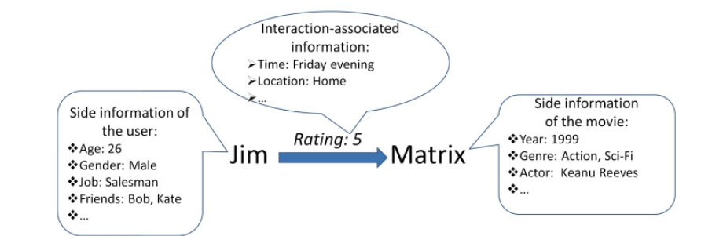
Alternative Information Sources for CF
Side information about User
Side information about item
Information regarding the situation where the interaction of user and item happens

Slide 22
Alternative Information Sources for CF
Social media
Assumption that users who stand in a positive relationship with each other may also share similar interests
User contributions
Tags
Geotags
Multimedia content
Free text reviews and comments

Slide 23
Alternative Information Sources for CF
Interaction-Associated information
Information sources that are directly related to the event of a user interacting (e.g., rating, purchasing) with an item [Adomavicius et al. 2011].
Timestamps
Hunger status of a user when she rated a food menu [Ono et al. 2009]
Location where a user downloaded a mobile application [B¨ohmer et al. 2011]

Slide 24
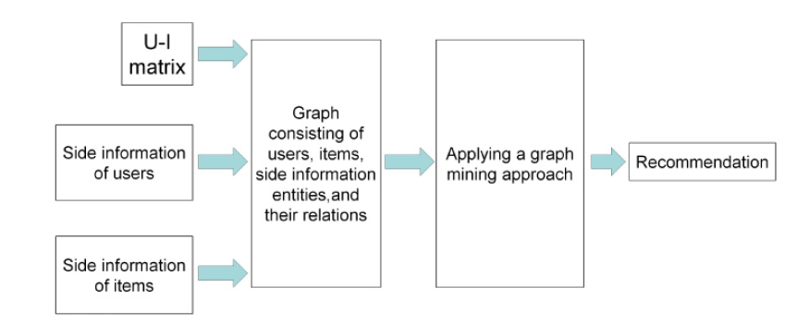
Graph Based CF
Link prediction in social networks [Liben-Nowell and Kleinberg 2003]
Typical example is the random walk and its variants [Tong et al. 2006]

Slide 25
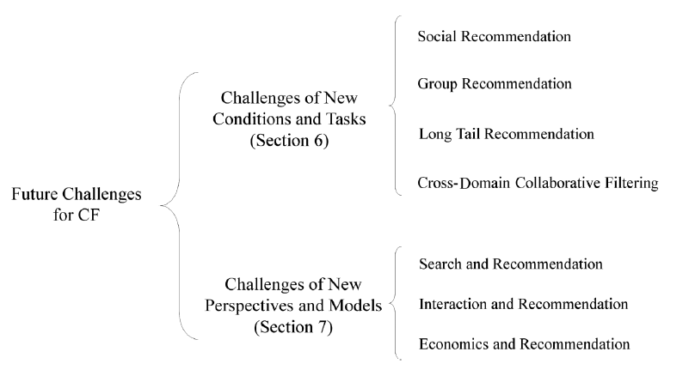
Challenges for Future CF

Slide 26
Challenges of new conditions and tasks
Social Recommendations
How do inherent properties of social networks interact with social recommendation?
The impact of varying levels of connectivity on recommender system performance.
How can mutual benefits between recommender systems and social networks be promoted?
The exact nature of the correlation between the similarity of users’ interests and the social relationship.
model/framework of social recommendation that can introduce mutual benefits between social networks and recommender systems is still missing.

Slide 27
Challenges of new conditions and tasks
Group Recommendation
How to model group-level preference?
The information available is only regarding a single user’s preference and combination of preferences may yield higher sparsity
Some group members maybe willing to sacrifice their own interests

Slide 28
Challenges of new conditions and tasks
Group Recommendation
What is the impact of group structure, and how to exploit it for group recommendation?
Different roles, such as leaders and followers
How to take into account the dynamics of a group for group recommendation?
Growing vs. dying groups and the underlying reasons

Slide 29
Challenges of new conditions and tasks
Long Tail Recommendation
How to promote the recommendation of tail items?
What is the added value of tail items, and how to exploit it in recommendation algorithms?
Influence user satisfaction and generate additional revenue
Other potential added value to be derived from long tail recommendation should be investigated
How to match long tail recommendations and users’ topical needs?
Adapting recommendations to a user’s topical interests
Notes:
Long tail : Items that have low popularity

Slide 30
Challenges of new conditions and tasks
Cross-Domain Collaborative Filtering
What to share?
What could be the common knowledge/data that can be transferred/shared between different domains
Understanding of cases in which CDCF could degrade the recommendation quality

Slide 31
Challenges of new conditions and tasks
Cross-Domain Collaborative Filtering
How to share?
What could be the optimal way to transfer/share knowledge between different domains
Algorithms to exploit multiple links simultaneously and automatically discover the relative importance of different links
High computational cost

Slide 32
Challenges of new perspectives and models
Search and Recommendation
Integration of search and recommendation technologies
Search Vs. Recommendation
Users are required to express their information need explicitly via queries Vs. the information is implicitly extracted

Slide 33
Challenges of new perspectives and models
Search and Recommendation
How can recommendation techniques help improve the quality of search results in the long tail?
How to allow search results to benefit from user votes but also maintain attack resistance?
Attacks in recommender systems refer to cases in which malicious users (attackers) assign high ratings deliberately to particular items in order to promote (or denigrate) those items [Lam and Riedl 2004; Mobasher et al. 2007]

Slide 34
Challenges of new perspectives and models
Interaction and Recommendation
Users adjust their behavior and expectations to the system [Ye and Johnson 1995]
Builds trust because the users can tell if they agree with the factors influencing recommendations produced by the system.
Recommender systems will generate more serendipitous results

Slide 35
Challenges of new perspectives and models
Interaction and Recommendation
How can the information from the interactions, such as conversations and explanations, be exploited effectively for improving the recommendation quality?
One possible approach is decision-making theory [Roe et al. 2001]

Slide 36
Challenges of new perspectives and models
Economics and Recommendation
Maintain the benefits of seller and satisfy the needs of buyer
Selecting and integrating economic models to optimize the recommender system output.
Correspondence between CF and social choice theory [Pennock et al. 2000].
Dependence of product’s utility on user’s past purchasing behavior [Wang and Zhang 2011]

Slide 37
Potential Research Area
Interaction and Recommendations
Decision making theories
Integrate with group recommendations
Multiple participant decision making theories
Economics and Recommendation
Economic Theories

Slide 38
Questions & comments
Parisa Lak

